Slide 1

Tableau Workshop
Young Career

Slide 2

Hello!
I am Lucy Wo
Why do we need to learn it?
What can we get from it?
How can we learn it together?

Slide 3
Course Introduction

Slide 4
Our process is easy
Section One
Section Two
(Some take-home questions)
Section Three
1
2
3

Slide 5


The end of class you will:
- Be able to certified Tableau Desktop certification
- Build interactive, insightful Dashboards

Slide 6
Section 1
Time: October 3rd: 8:00pm-10:00pm
(5 mins break at 9:00 pm)
Agenda:
Load Data
Introduction of the Tableau Interface
Data Types
Bar Charts
Line Charts
Map
Pie Charts

Slide 7
Section 2
2
Time: October 10th: 8:00pm-10:00pm
(5 mins break at 9:00 pm)
Agenda:
Create Variables
Filter
Parameter
Table calculation
Design Dashboard

Slide 8
Section 3
3
Time: October 17th: 8:00pm-10:00pm
(5 mins break at 9:00 pm)
Agenda:
Go through homework questions
Dashboard Actions
Build Story

Slide 9
Introduction
Real-world example
Experience with the spreadsheet (excel, google sheets)
Limited of the Tableau Public
Tableau trial lasts for 14 days
Download Tableau Free Trail:
www.tableau.com
Product page - > tableau desktop -> Try now -> start free trial -> sigh up and download

Slide 10

Tableau Products
- Tableau Prep Builder:
help you make data ready
prepare and clean data
for example, clean columns
- Tableau Desktop
- Tableau server:
online server
create an account for different users
- Tableau mobile:
mobile users

Slide 11
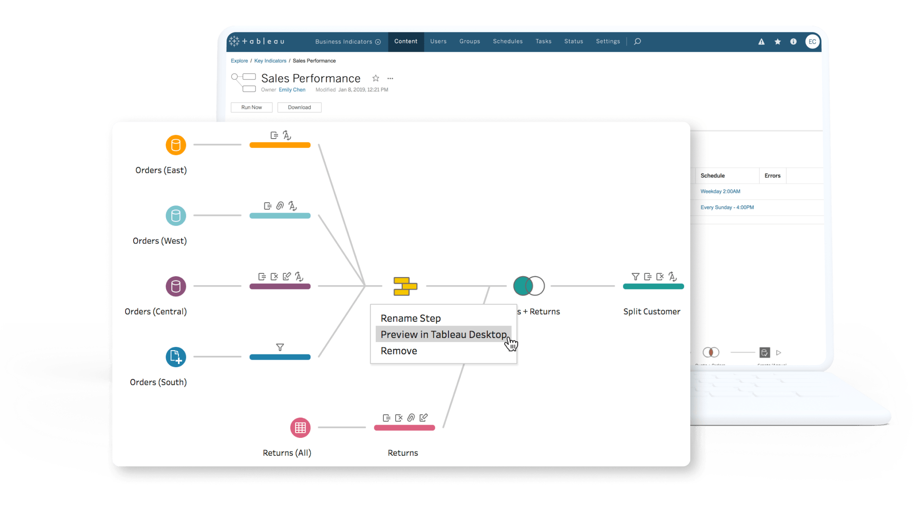
Tableau Prep Builder

Slide 12
Introducing Tableau
Tableau file types
Open Help
Connect to excel data source
Tableau workbook (.twb): store a visualization without source data
Tableau packages workbook (.twbx): stores extracted data and visualizations for viewing
Tableau data source (.tds): store the server address,, pw and other access information
Go to support
Any updates request
Setting Languages
# sheets
# fields
# rows
Review sample data
installed connectors/ additional connectors

Slide 13
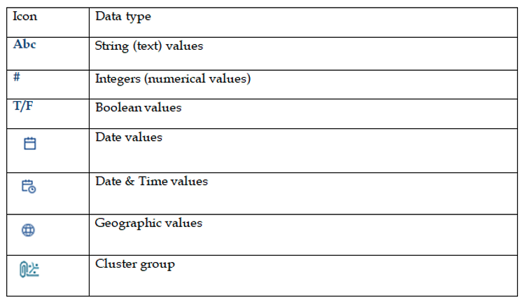
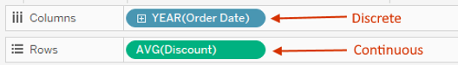
Tableau Data Types and Roles
Dimension fields (green): they either categorize, segment or reveal the details in your data.
Measure fields(blue): Tableau applies aggregation by default.

Slide 14
Reorder fields
Drag a filed into columns and rows
Resize table
Pivot Data
Clean up source data
Skip the top row
Sheet 1 table
Use data interpreter: look the data to auto fix
Split text into multiple columns
New dataset
Split/custom split
rename
…..

Slide 15
Manage the worksheets
Change worksheet tab color
Delete
Add
Click the button
Worksheet-> new worksheet
Duplicate
sheets not connected
Rename
Reorder
Clear
right click then delete (no warning)
we can revert by click control/cmd Z
none is default

Slide 16
Show/Hide worksheet’s elements
Show/Hide navigation pane
Show/Hide all the cards
Show/Hide columns and rows
Show/Hide title, caption and summary cards

Slide 17

Save
Save the changes:
Save as the packaged workbook
Click the save button
Control + S
Go to File -> click save
Export data to csv
Save
Export visualization to PPT

Slide 18

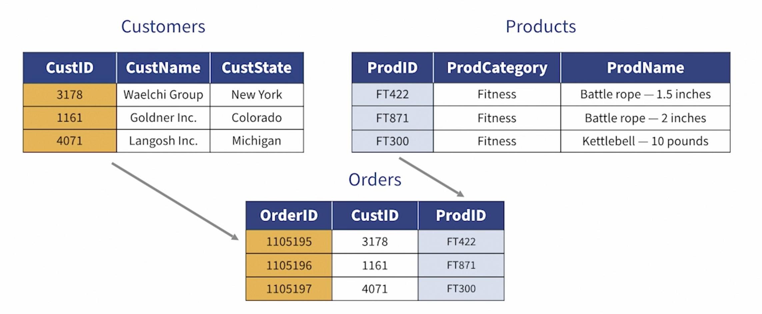
Join using common Fields
Drag orders, customers, and products sheets
Relationship area
Select the columns from each table

Slide 19
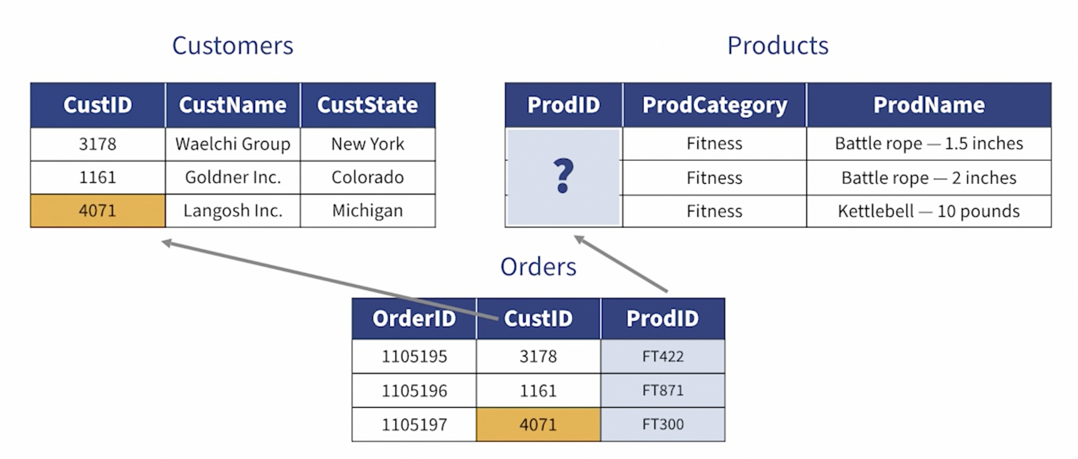
Join using fields with different names
Drag orders, customers, and products sheets
Relationship area
Select the columns from each table

Slide 20

Create custom calculations and fields
Mathematic Calculations:
+ (include date),string concatenation:
Aug 2 +3 = Aug 5 ‘Lucy’ + ‘ ‘ + ’Wo’ = ‘Lucy Wo’
- : -(4+6) = -10
*, /
% mode return remainder: 27%12=3
^ exponents,
=, <>, <=,
Logical operators :
and, or, not
A=True, B=False then:
A AND B => False A OR B => True NOT (A AND B) => True
Build in calculated functions:
sum, avg, min, max, stdev(to see how spread out the dataset is), abs(distance from 0)
ceiling (round up to the next integer), floor
round(number, decimals)

Slide 21
Thanks!
😉
Any questions?
You can find me at
lucy.siyuwo@gmail.com

Slide 22
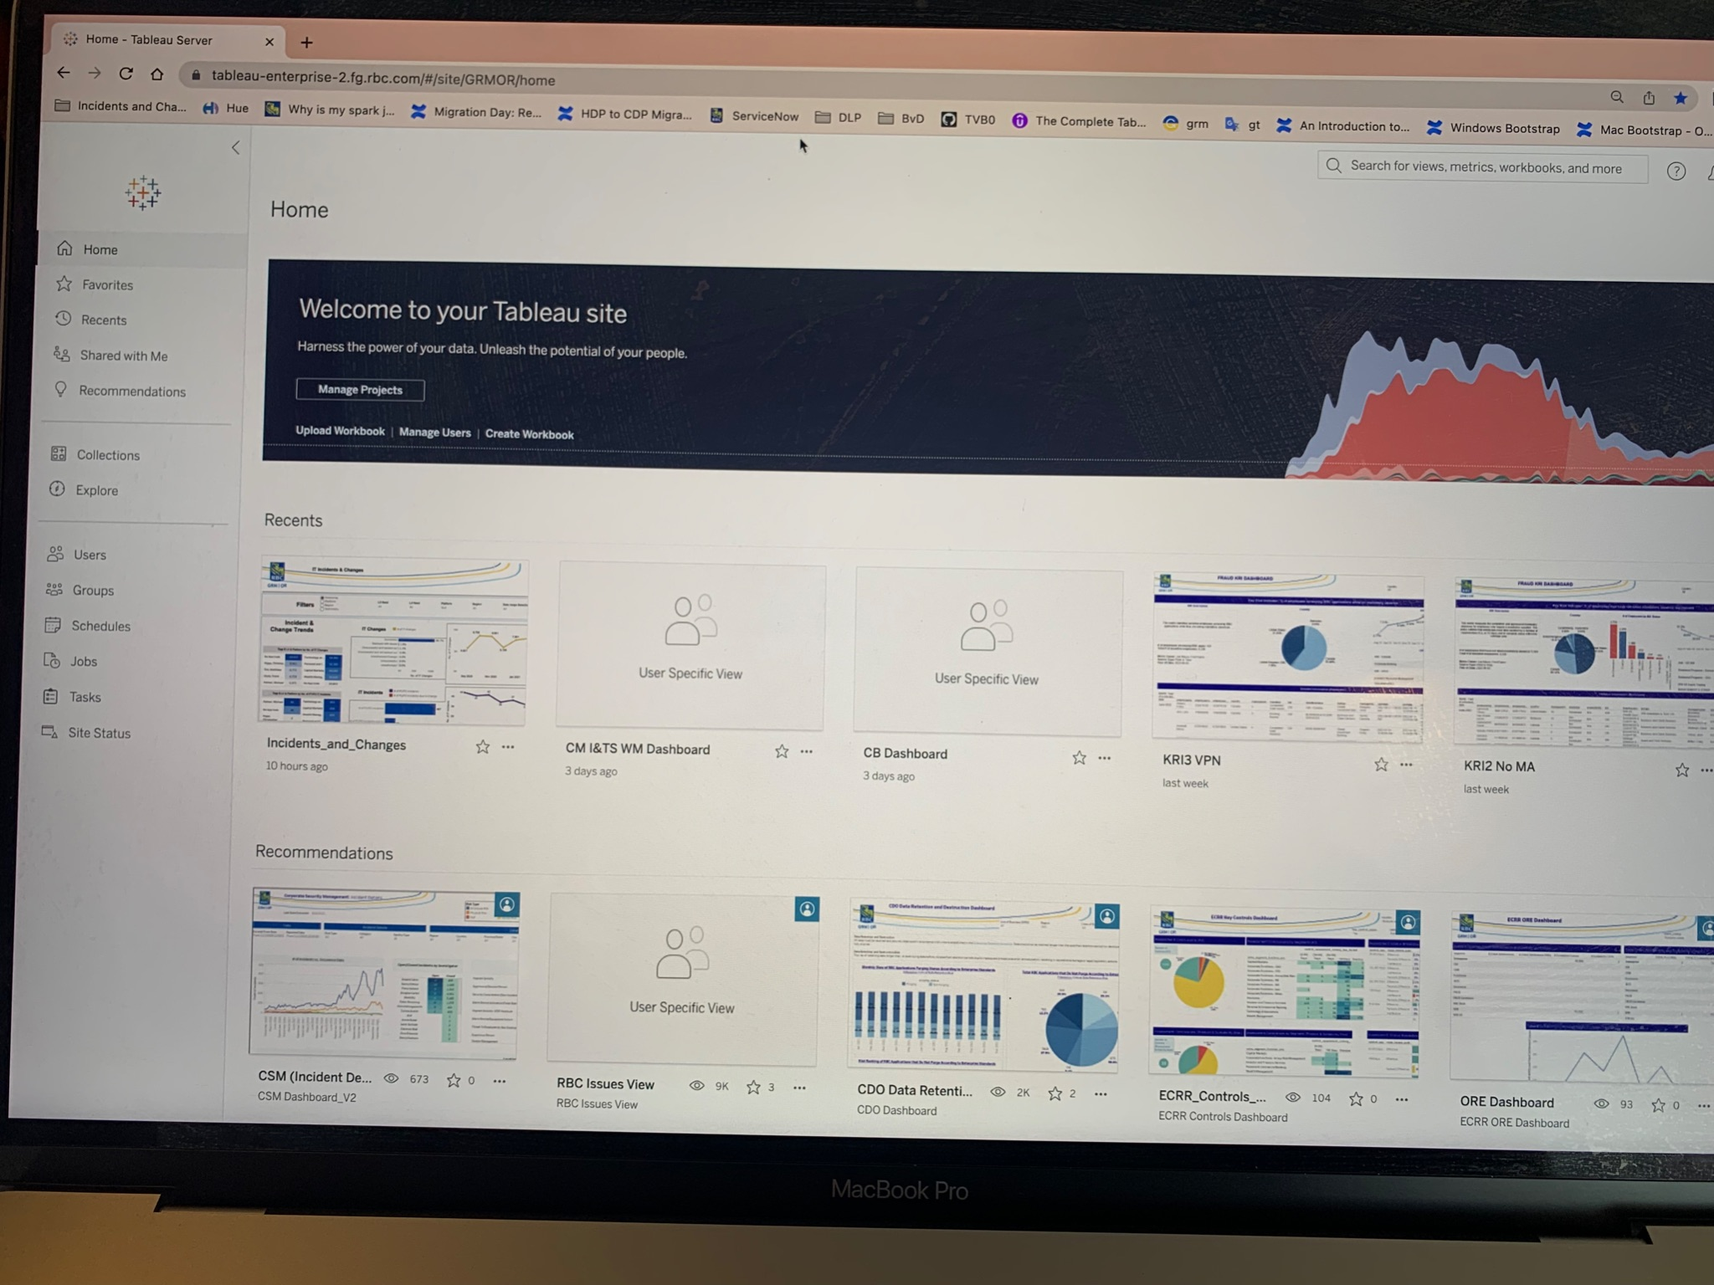

Slide 23
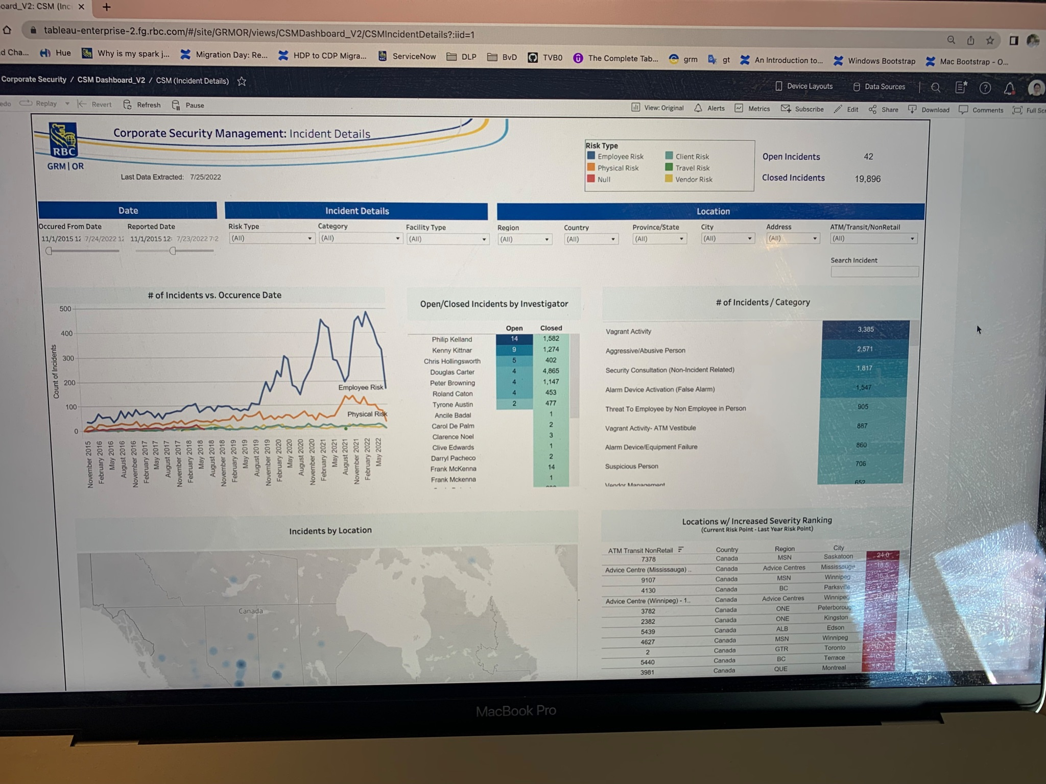

Slide 24
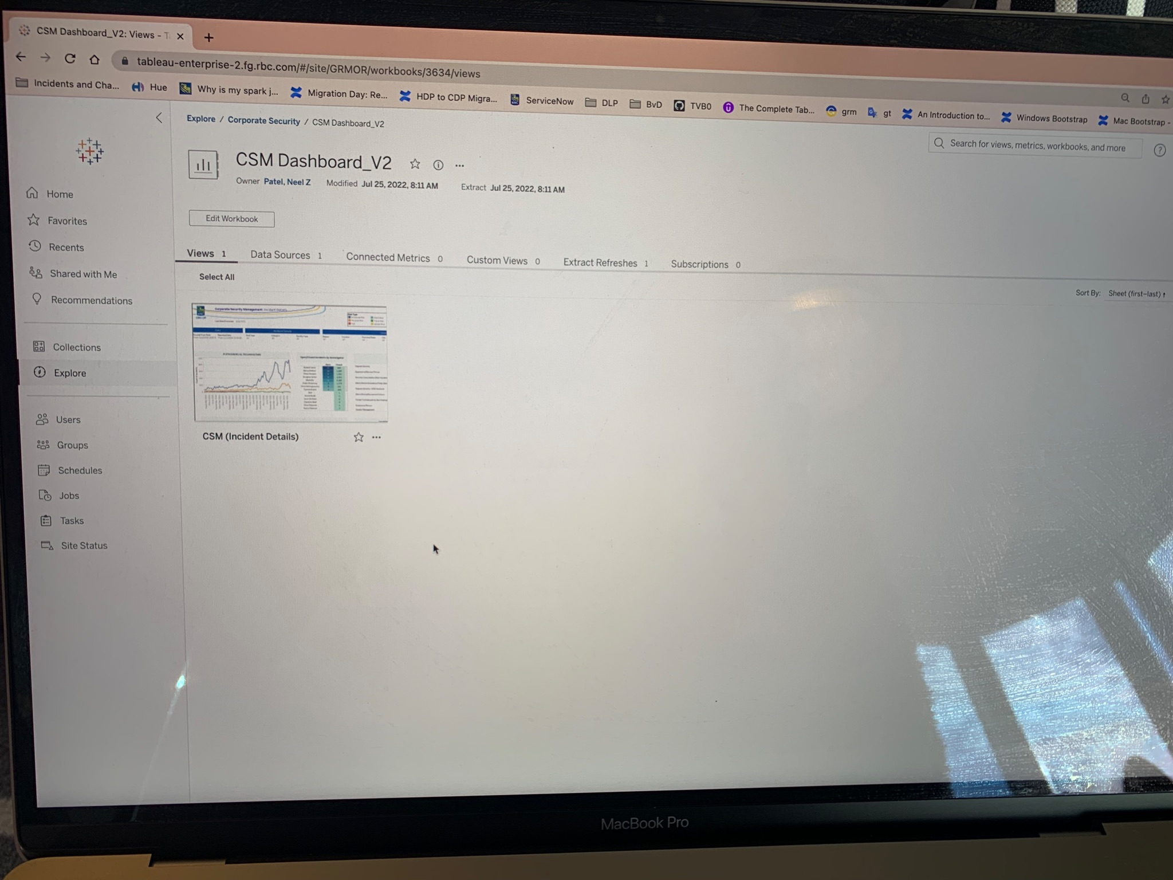

Slide 25
